Slide 1
Basel I, Basel II, and Solvency II
Chapter 25

Slide 2
History of Bank Regulation
Pre-1988
1988: BIS Accord (Basel I)
1996: Amendment to BIS Accord
1999: Basel II first proposed

Slide 3
Pre-1988
Banks were regulated using balance sheet measures such as the ratio of capital to assets
Definitions and required ratios varied from country to country
Enforcement of regulations varied from country to country
Bank leverage increased in 1980s
Off-balance sheet derivatives trading increased
LDC debt was a major problem

Slide 4
1988: BIS Accord (Section 25.3)
Main Provisions:
Capital must be 8% of risk weighted amount.
At least 50% of capital must be Tier 1

Slide 5
Types of Capital (Section 25.3.2)
Tier 1 Capital: common equity, non-cumulative perpetual preferred shares
Tier 2 Capital: cumulative preferred stock, certain types of 99-year debentures, subordinated debt with an original life of more than 5 years

Slide 6
Risk-Weighted Capital
A risk weight is applied to each on-balance- sheet asset according to its risk (e.g. 0% to cash and govt bonds; 20% to claims on OECD banks; 50% to residential mortgages; 100% to corporate loans, corporate bonds, etc.)
For bilateral OTC derivatives and off-balance sheet commitments, first calculate a credit equivalent amount is calculated and then a risk weight is applied
Risk weighted amount (RWA) consists of
  Sum of products of risk weight times asset amount for on-balance sheet items
  Sum of products of risk weight times credit equivalent amount for derivatives and off-balance sheet commitments

Slide 7
Credit Equivalent Amount for Derivatives
The credit equivalent amount is calculated as the current replacement cost (zero if negative) plus an add on factor. (This is known as the current exposure method, CEM)
The add on amount varies from instrument to instrument (e.g. 0.5% for a 1-5 year interest rate swap; 5.0% for a 1-5 year foreign currency swap)

Slide 8
Add-on Factors (% of Principal) Table 25.2
Remaining Maturity (yrs) | Interest rate | Exch Rate and Gold | Equity | Precious Metals except gold | Other Commodities
<1 | 0.0 | 1.0 | 6.0 | 7.0 | 10.0
1 to 5 | 0.5 | 5.0 | 8.0 | 7.0 | 12.0
>5 | 1.5 | 7.5 | 10.0 | 6.0 | 15.0
Example: A $100 million swap with 3 years to maturity worth $5 million would have a credit equivalent amount of $5.5 million

Slide 9
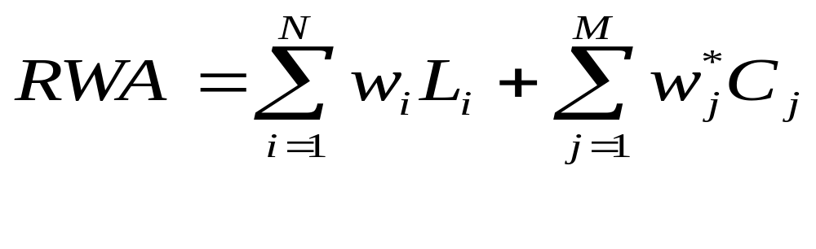
The Math
On-balance sheet assets: principal times risk weight
Derivatives and off-balance sheet commitments: credit equivalent amount times risk weight
For a derivative C_{j} = max(V_{j},0) + a_{j}L_{j} where V_{j} is value, L_{j} is principal and a_{j} is add-on factor

Slide 10
G-30 Policy Recommendations
(Section 25.4)
Influential publication from derivatives dealers, end users, academics, accountants, and lawyers
20 recommendations published in 1993

Slide 11
Netting (Section 25.5)
Netting refers to a clause in Master Agreements, which states that all OTC derivatives with a counterparty are treated as a single transaction in the event of a default
In 1995 the 1988 accord was modified to allow banks to reduce their credit equivalent totals when bilateral netting agreements were in place

Slide 12


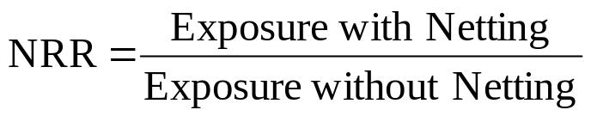
Netting Calculations
Without netting exposure is
With netting exposure is

Slide 13


Netting Calculations continued
Credit equivalent amount modified from
to

Slide 14
1996 Amendment (Section 25.6)
Implemented in 1998
Requires banks to hold capital for market risk for all instruments in the trading book including those off balance sheet (This is in addition to the BIS Accord credit risk capital)

Slide 15

The Market Risk Capital
The capital requirement is
where m_{c} is a multiplicative factor chosen by regulators (at least 3), VaR is the 99% 10-day value at risk, and SRC is the specific risk charge for idiosyncratic risk related to specific companies. VaR_{t-1} is the most recently calculated VaR and VaR_{avg} is the average VaR over the last 60 days

Slide 16
Basel II
Implemented in 2007
Three pillars
  New minimum capital requirements for credit and operational risk
  Supervisory review: more thorough and uniform
  Market discipline: more disclosure

Slide 17
New Capital Requirements
Risk weights based on either external credit rating (standardized approach) or a bank’s own internal credit ratings (IRB approach)
Recognition of credit risk mitigants
Separate capital charge for operational risk

Slide 18
USA vs European Implementation
In US Basel II applies only to large international banks
Small regional banks required to implement “Basel 1A’’ (similar to Basel I), rather than Basel II
European Union requires Basel II to be implemented by securities companies as well as all banks

Slide 19
New Capital Requirements
Standardized Approach, Table 25.4
Bank and corporations treated similarly (unlike Basel I)
Rating | AAA to AA- | A+ to A- | BBB+ to BBB- | BB+ to BB- | B+ to B- | Below B- | Unrated
Country | 0% | 20% | 50% | 100% | 100% | 150% | 100%
Banks | 20% | 50% | 50% | 100% | 100% | 150% | 50%
Corporates | 20% | 50% | 100% | 100% | 150% | 150% | 100%

Slide 20
New Capital Requirements
IRB Approach for corporate, banks and sovereign exposures
Basel II provides a formula for translating PD (probability of default), LGD (loss given default), EAD (exposure at default), and M (effective maturity) into a risk weight
Under the Advanced IRB approach banks estimate PD, LGD, EAD, and M
Under the Foundation IRB approach banks estimate only PD and the Basel II guidelines determine the other variables for the formula

Slide 21
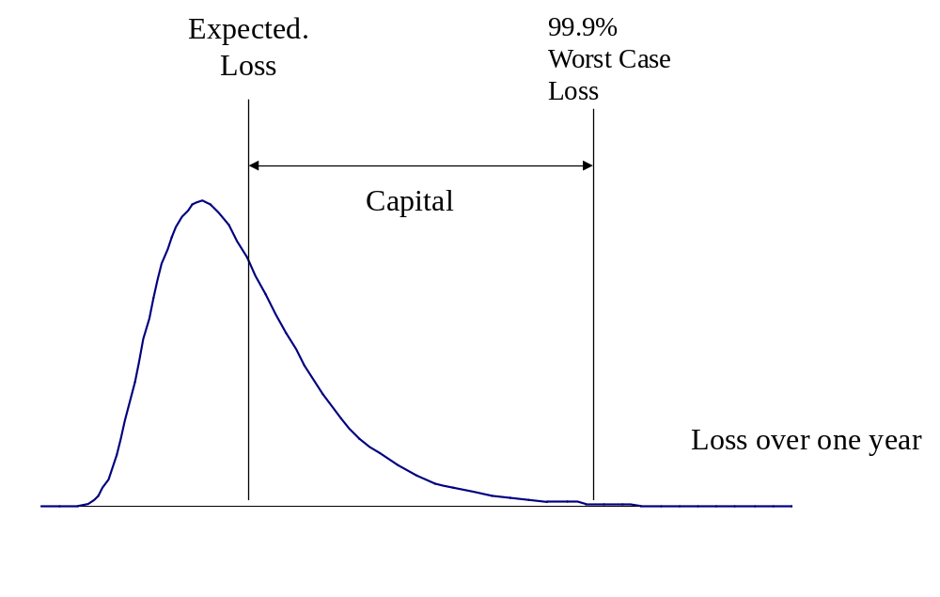
The Model used by Regulators (Figure 25.1)

Slide 22
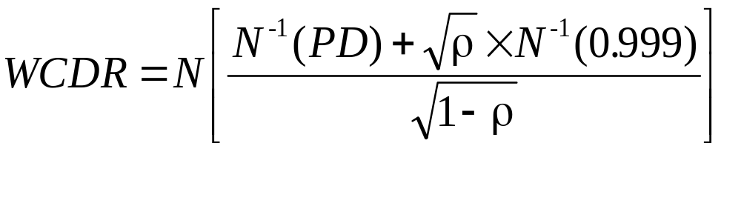
Key Model (Gaussian Copula)
The 99.9% worst case default rate is base don Vasicek’s model:

Slide 23
Numerical Results for WCDR
(Table 25.5)
 | PD=0.1% | PD=0.5% | PD=1% | PD=1.5% | PD=2%
ρ=0.0 | 0.1% | 0.5% | 1.0% | 1.5% | 2.0%
ρ=0.2 | 2.8% | 9.1% | 14.6% | 18.9% | 22.6%
ρ=0.4 | 7.1% | 21.1% | 31.6% | 39.0% | 44.9%
ρ=0.6 | 13.5% | 38.7% | 54.2% | 63.8% | 70.5%
ρ=0.8 | 23.3% | 66.3% | 83.6% | 90.8% | 94.4%

Slide 24
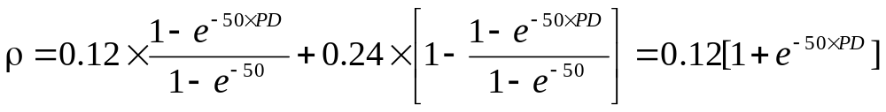
Dependence of ρ on PD
For corporate, sovereign and bank exposure
  (For small firms ρ is reduced)
PD | 0.1% | 0.5% | 1.0% | 1.5% | 2.0%
WCDR | 3.4% | 9.8% | 14.0% | 16.9% | 19.0%

Slide 25
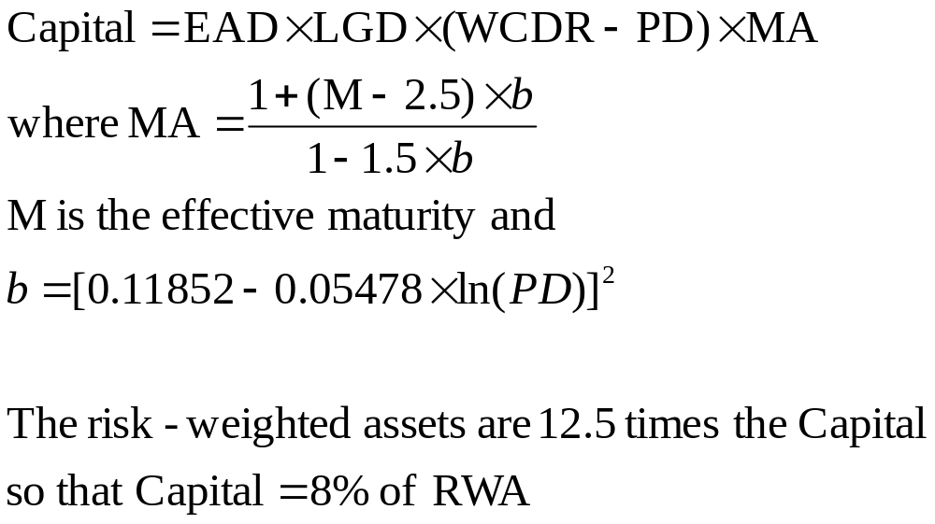
Capital Requirements

Slide 26
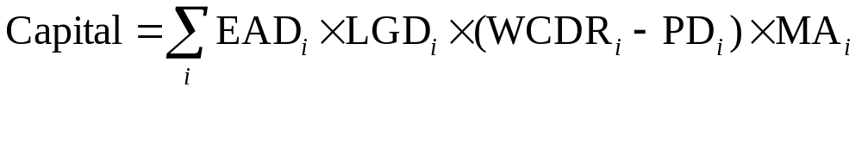
Extension
For a portfolio where PDs, EADs, etc. are different, Gordy shows that, in a one-factor world, Vasicek’s model can be extended

Slide 27
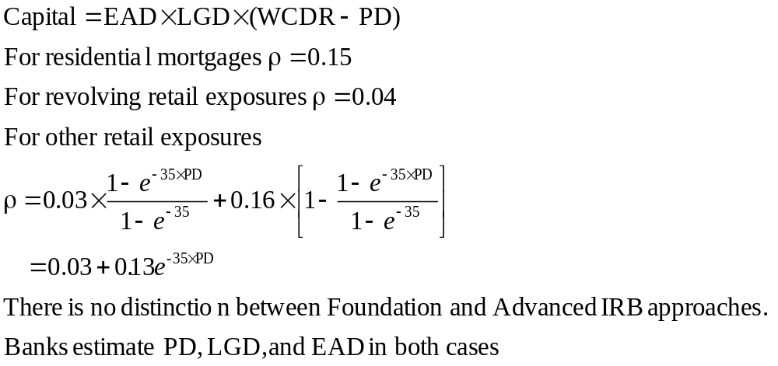
Retail Exposures

Slide 28
Credit Risk Mitigants
Credit risk mitigants (CRMs) include collateral, guarantees, netting, the use of credit derivatives, etc
The benefits of CRMs increase as a bank moves from the standardized approach to the foundation IRB approach to the advanced IRB approach

Slide 29
Adjustments for Collateral
Two approaches
  Simple approach: risk weight of counterparty replaced by risk weight of collateral
  Comprehensive approach: exposure adjusted upwards to allow to possible increases; value of collateral adjusted downward to allow for possible decreases; new exposure equals excess of adjusted exposure over adjusted collateral; counterparty risk weight applied to the new exposure

Slide 30
Guarantees
Traditionally the Basel Committee has used the credit substitution approach (where the credit rating of the guarantor is substituted for that of the borrower)
However, this overstates the credit risk because both the guarantor and the borrower must default for money to be lost
As a result, the Basel Committee developed a formula reflecting double default risk

Slide 31
Operational Risk Capital
Basic Indicator Approach: 15% of gross income
Standardized Approach: different multiplicative factor for gross income arising from each business line
Internal Measurement Approach: capital equals one-year 99.9% VaR loss minus expected one year loss

Slide 32
Supervisory Review Changes
Similar amount of thoroughness in different countries
Local regulators can adjust parameters to suit local conditions
Importance of early intervention stressed

Slide 33
Market Discipline
Banks will be required to disclose
  Scope and application of Basel framework
  Nature of capital held
  Regulatory capital requirements
  Nature of institution’s risk exposures

Slide 34
Solvency II (Section 25.12)
Similar three pillars to Basel II
Pillar I specifies the minimum capital requirement (MCR) and solvency capital requirement (SCR)
If capital falls below SCR the insurance company must submit a plan for bringing it back up to SCR.
If capital drops below MCR supervisors may prevent the insurance company from taking new business

Slide 35
Solvency II continued
Internal models vs standardized approach
One year 99.5% confidence for internal models
Capital charge for investment risk, underwriting risk, and operational risk
Three types of capital

